Slide 1
Here are the 20 Aquatic Birds you need to know

Slide 2
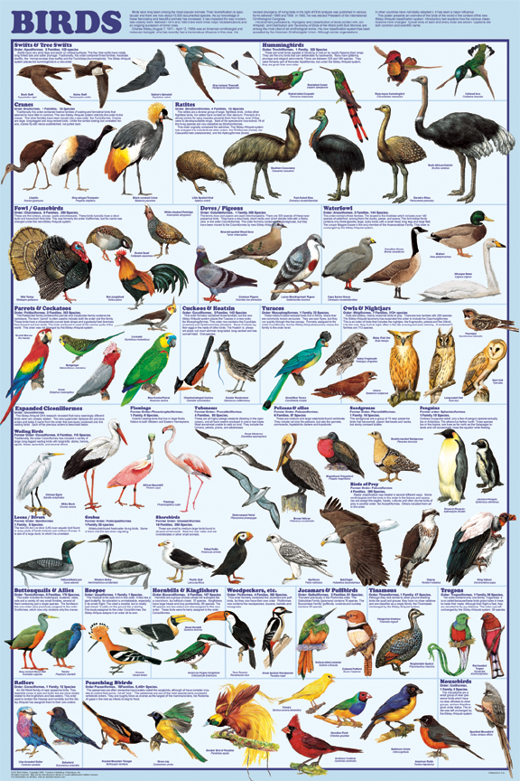
There are about 10,050 species of birds in the world. You only have to learn 20

Slide 3
So as you learn each of your 20 species, ask three questions:
1. What adaptations does this bird
have for an aquatic lifestyle?
2. What can you tell about its ecological
niche just by looking at its body?
3. What recognition features does this bird
have?

Slide 4
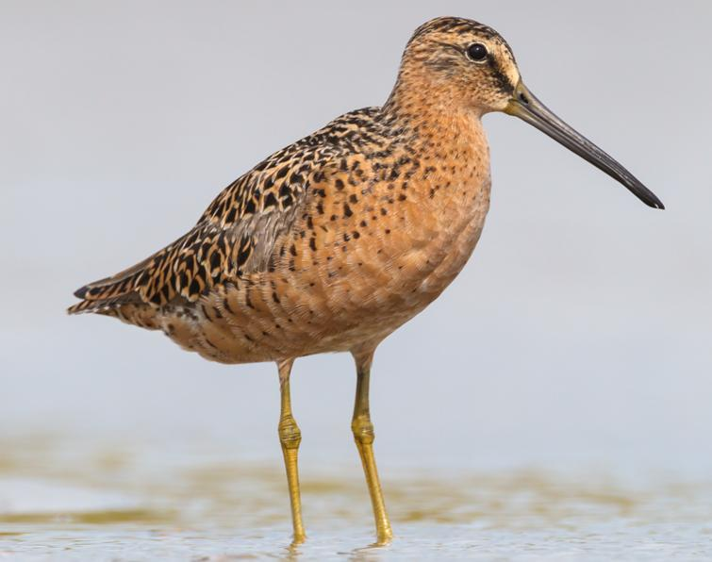
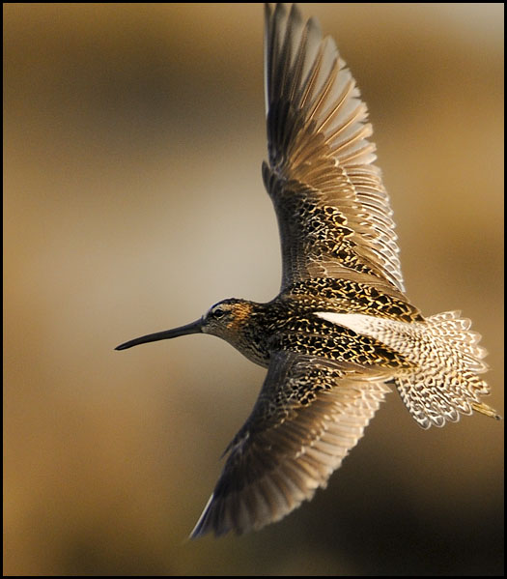
1. dowitcher
Looooong beak
Stilt-like yellow legs
Speckled back

Slide 5
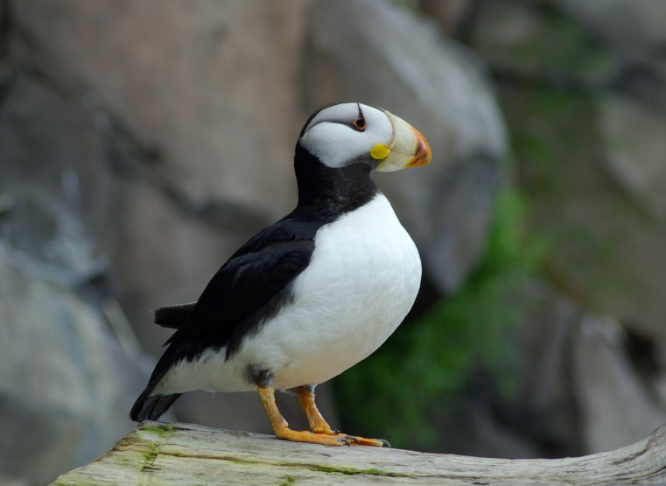
2. Horned puffin
Counter shading
High multi-colored beak
Vertical eye-liner looks a little like a horn

Slide 6
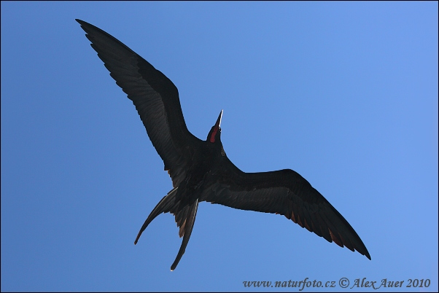
3. Magnificent frigatebird
Long beak, hooked at the tip
Built for speed: narrow pointed wings; lunate tail
Males with inflatable red throat patch

Slide 7
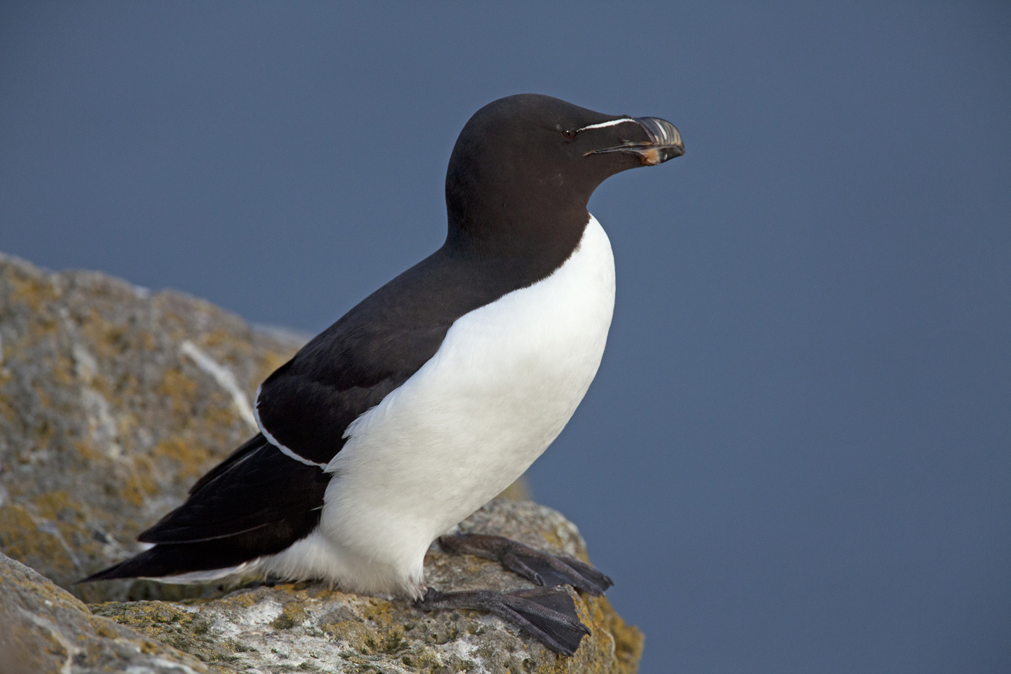
4. Razorbill
Counter-shading
Webbed feet
White strip along beak

Slide 8
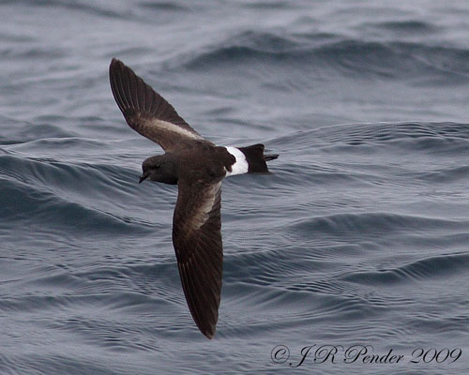
5. Storm petrel
Dark gray (soot) color
Webbed feet
Tube nose

Slide 9
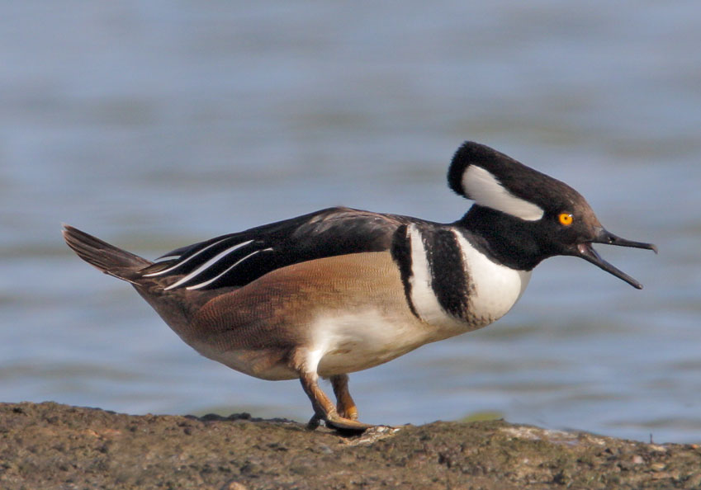
6. Hooded merganser
Flexible black and white crest (males)
Webbed feet
Toothed/serrated margin on beak

Slide 10
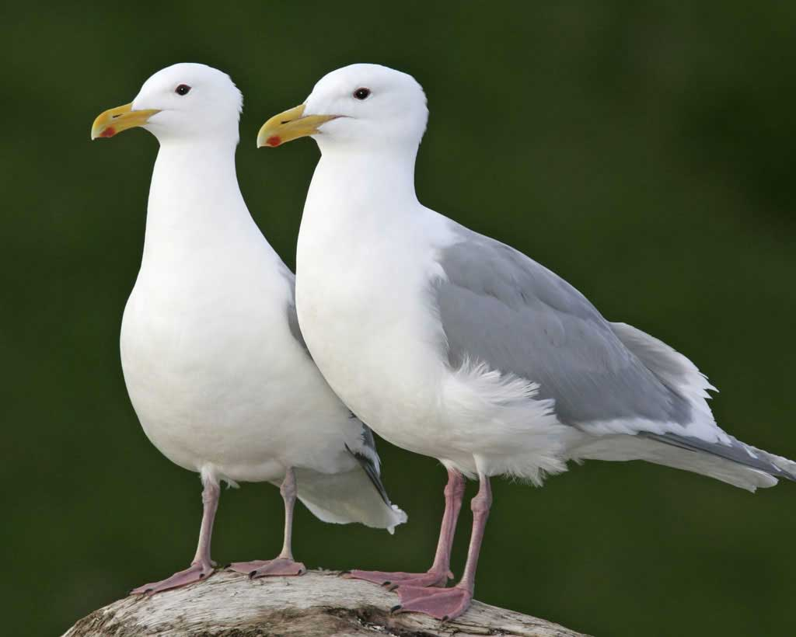
7. glaucous-winged gull
White with grey wings
Webbed feet
Pink legs
Yellow beak with reddish spot on lower mandible

Slide 11
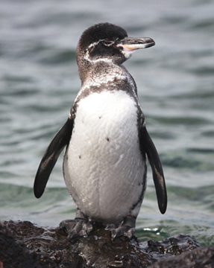
8. Galápagos penguin
Typical penguin features: counter-shading, wings modified into flippers
Only penguin found north of the equator
Second smallest penguin

Slide 12
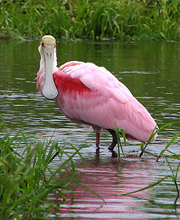
9. Roseate spoonbill
Pink plumage
Spatulate (spoon-shaped) bill
Wading legs (stilts)

Slide 13
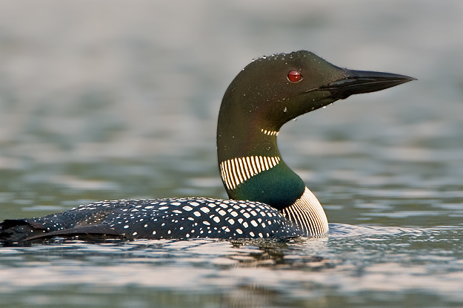
10. Common loon (“diver” in U.K.)
Black head with red eye
Black beak
Striped and black collars
Legs attached far back

Slide 14
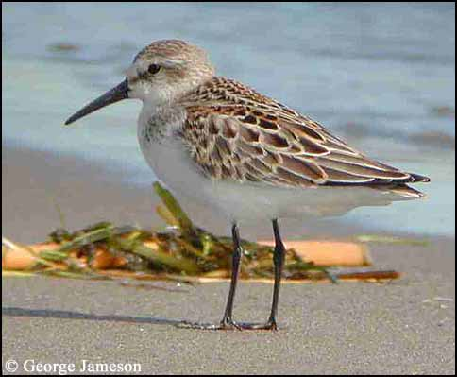
11. Western sandpiper
Thin probing bill
Long black legs
Slightly webbed feet

Slide 15
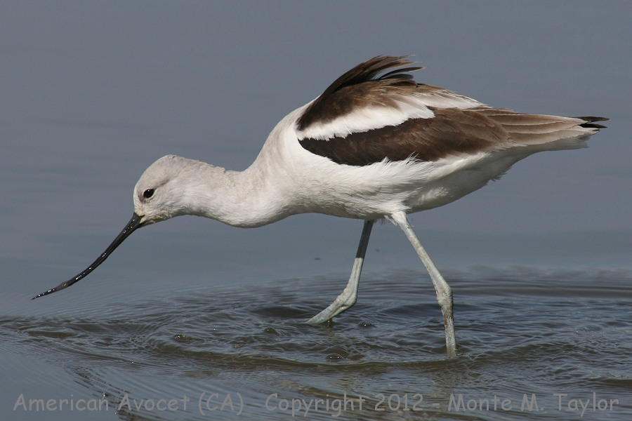
12. (American) avocet
Thin upturned beak
Stilt-like legs
Two color phases

Slide 16
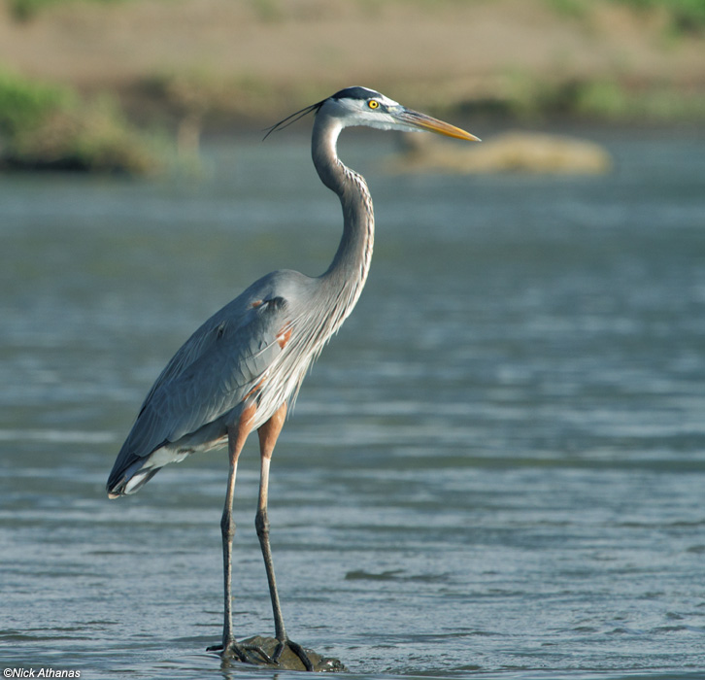
13. Great blue heron
S shaped neck
Stilt legs and wide-splayed wader toes
Spear tip yellow beak
Two dark pony tails

Slide 17
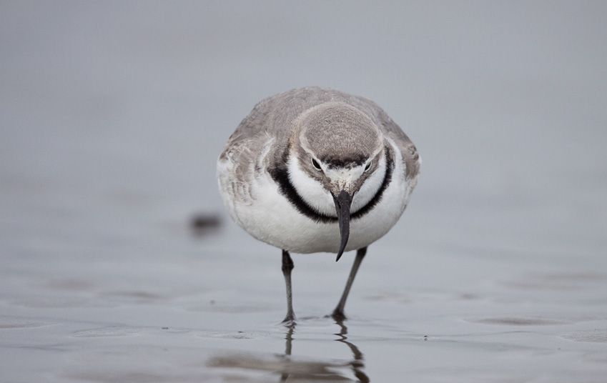
14. wrybill
Dark collar across chest
Only bird in the world with a beak turned to the right
Endemic to New Zealand

Slide 18
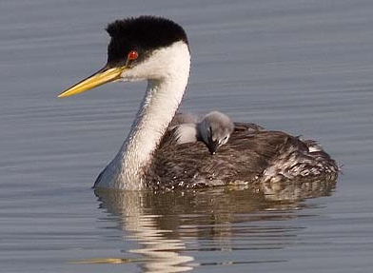
15. Western grebe
Black cap with red eye, long white neck
Yellow beak
Legs attached far back

Slide 19
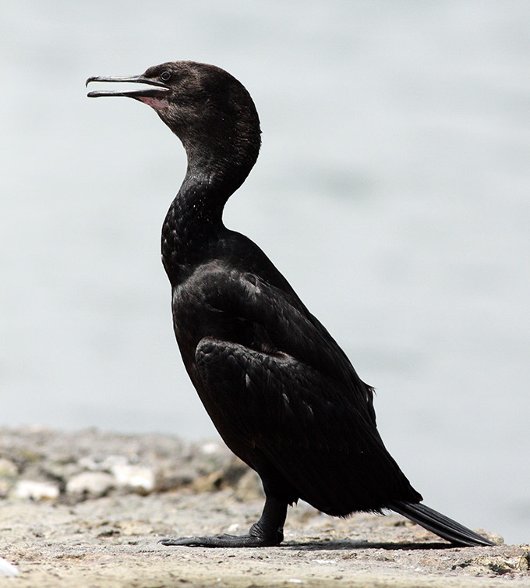
16. Pelagic cormorant
All black (no counter shading)
Beak hooks at tip
Small pouch (like a junior pelican)

Slide 20
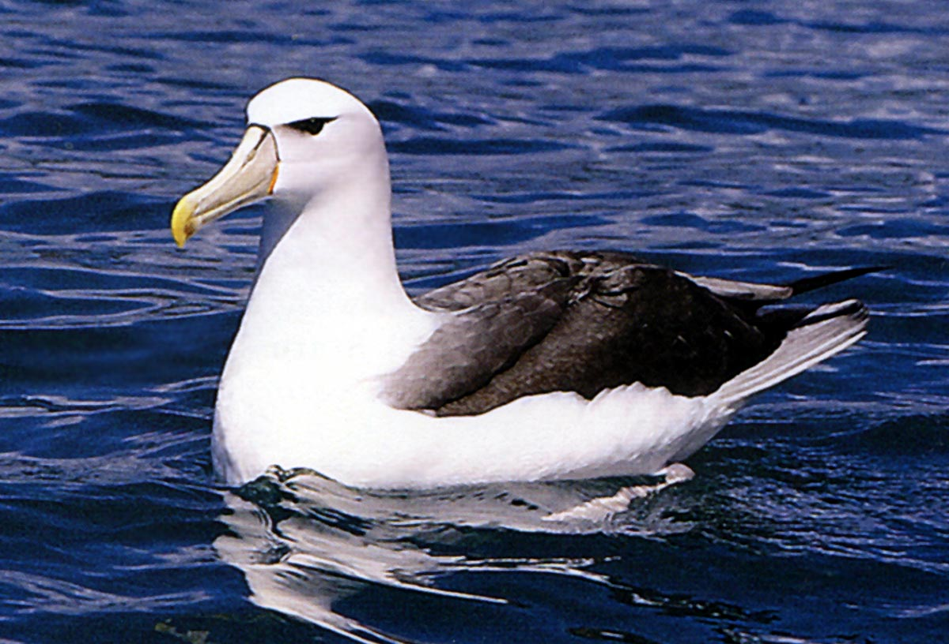
17. Wandering albatross
Gull-like appearance
Tube nose
Incredible wing span

Slide 21
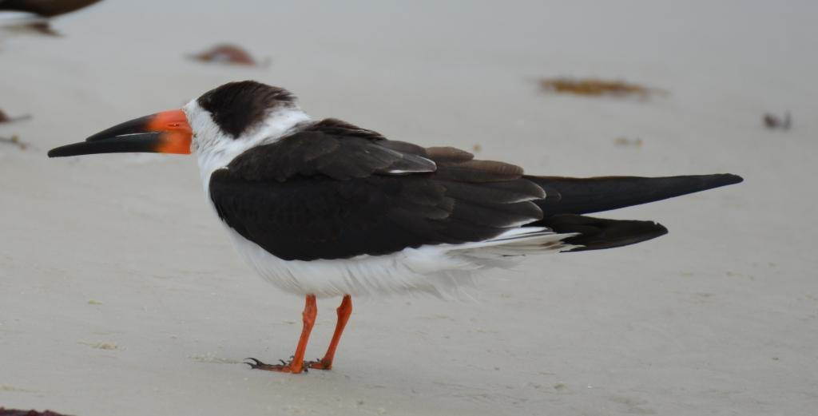
18. Black skimmer
Unusual beak with extended lower mandible
Small legs
Black cap

Slide 22
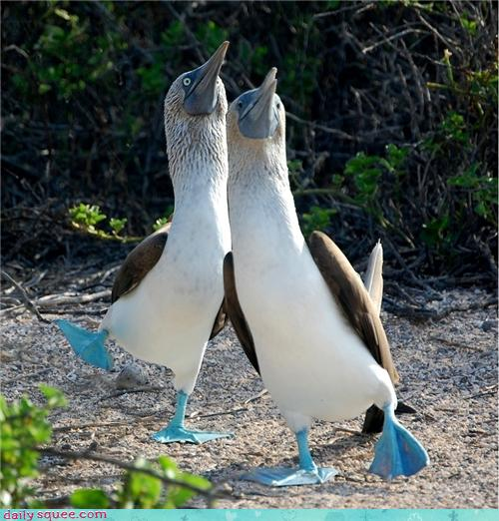
19. Blue-footed booby
Counter shading
Built for diving from the sky: even has permanently closed nostrils
Blue webbed feet

Slide 23
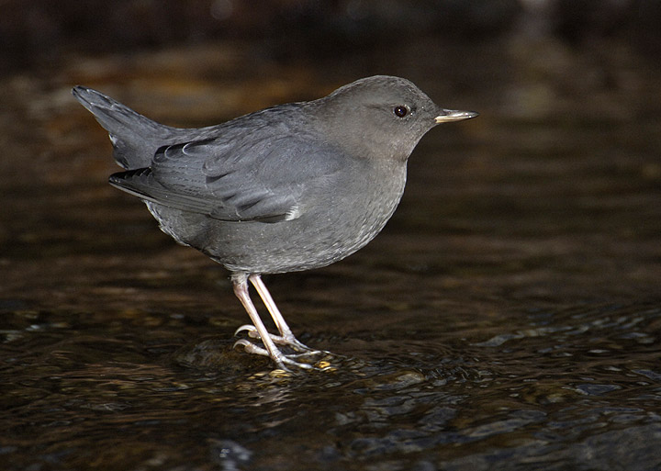
20. American dipper (water ouzel)
Chunky body with gray plumage
Short tail
Specialized scales that seal off nostrils when it dives

